Slide 1


General Biology lab
Al-Karkh University for Science
Collage of Science
Microbiology Department
Dr. Rawa Abdul Redha Aziz
Ph.D Antibiotics/ Molecular biology
Laboratory Staff:
1. Lecturer Dr. Rawa Abdul Redha Aziz
2. L. assistant Sura Alaa Saud
3. L. assistant Gada Readh
Supervised by:
1. Prof. Munira Ch. Ismaeel
2. Ass. Prof. Israa AJ Ibrahim

Slide 2
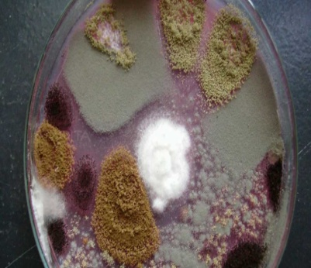
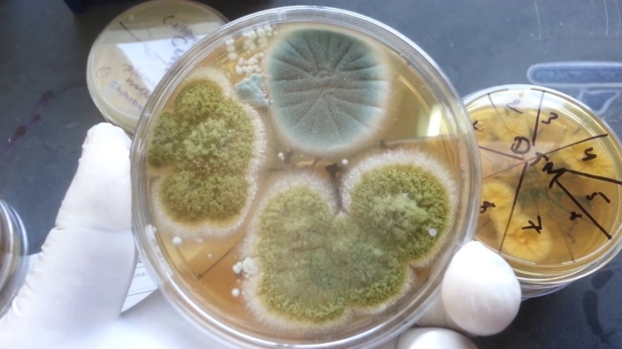
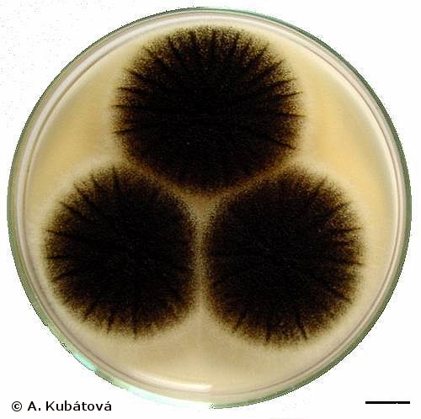
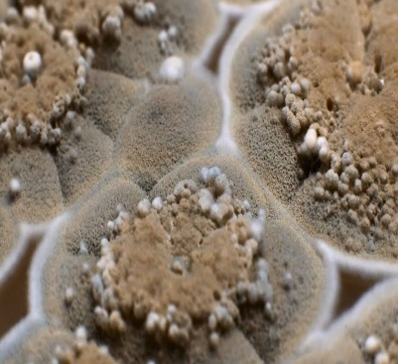
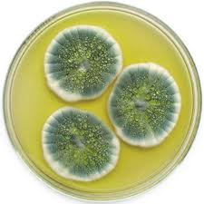
Lab 9: Fungi culture and identification

Slide 3
Molds are multinucleated, filamentous fungi composed of hyphae. A hypha is a branching, tubular structure from 2-10 µm in diameter and is usually divided into cell-like units by crosswalls called septa.
The total mass of hyphae is termed a mycelium. The portion of the mycelium that anchors the mold and absorbs nutrients is called the vegetative mycelium; the portion that produces asexual reproductive spores is termed the aerial mycelium.

Slide 4
Molds possess a rigid polysaccharide cell wall composed mostly of chitin and, like all fungi, are eukaryotic. Molds reproduce primarily by means of asexual reproductive spores such as conidiospores, sporangiospores, and arthrospores.
These spores are disseminated by air, water, animals or objects and upon landing on a suitable environment, germinate and produce new hyphae.
Molds may also reproduce by means of sexual spores such as ascospores and zygospores, but this is not common. The form and manner in which the spores are produced, along with the appearance of the hyphae and mycelium, provide the main criteria for identifying and classifying molds.

Slide 5
Common Molds: Conidiospores (Penicillium and Aspergillus)
Sporangiospores (Rhizopus)
** Molds are commonly cultured on fungal-selective or enriched media such as Saboraud Dextrose agar (SDA), Corn Meal agar, and Potato Dextrose agar.
Dermatophytes Microsporum,
Trichophyton, and Epidermophyton.
Dimorphic fungi Coccidioides immitis
Histoplasma capsulatum
Blastomyces dermatitidis
**These organisms grow well at 25°C. They can grow well on Dermatophyte Test Medium (DTM) and Saboraud Dextrose agar (SDA).

Slide 6
Materials
light microscope, slides, and cover slides
PDA plates
Spoiled fruits like (apple, orange, or banana)
Simple stain
Spoiled vegetables (tomato, potato, onion, and others)
Sterilized swab
Wooden stick
burner

Slide 7
Lab procedure
Three types of observation you can perform, and they are:
From the spoiled part of fruits or vegetables, take a touch by the sterilized swab and culture it on PDA plates. Then incubate the plates at 25°C for 48-72h.
Take with a wooden stick a piece of spoiled area and mix it with a drop of D.W to make a wet mount slide. Then observe it under light microscope.
Perform simple stain using methylene blue.
More probably, Penicillium, Aspergillus, and Rhizopus will be observed. Note the following:
The colony appearance
Color
The type and form of the asexual spores produced.
Focus first using the yellow-striped 10X objective (100X magnification) and then rotate to the 40X objective (400X magnification).

Slide 8
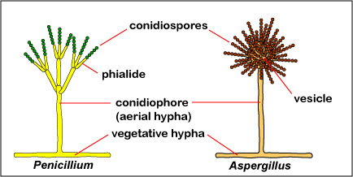
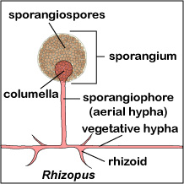
Figure 1: Fungal Conidiospores Fungal Sporangiospores

Slide 9
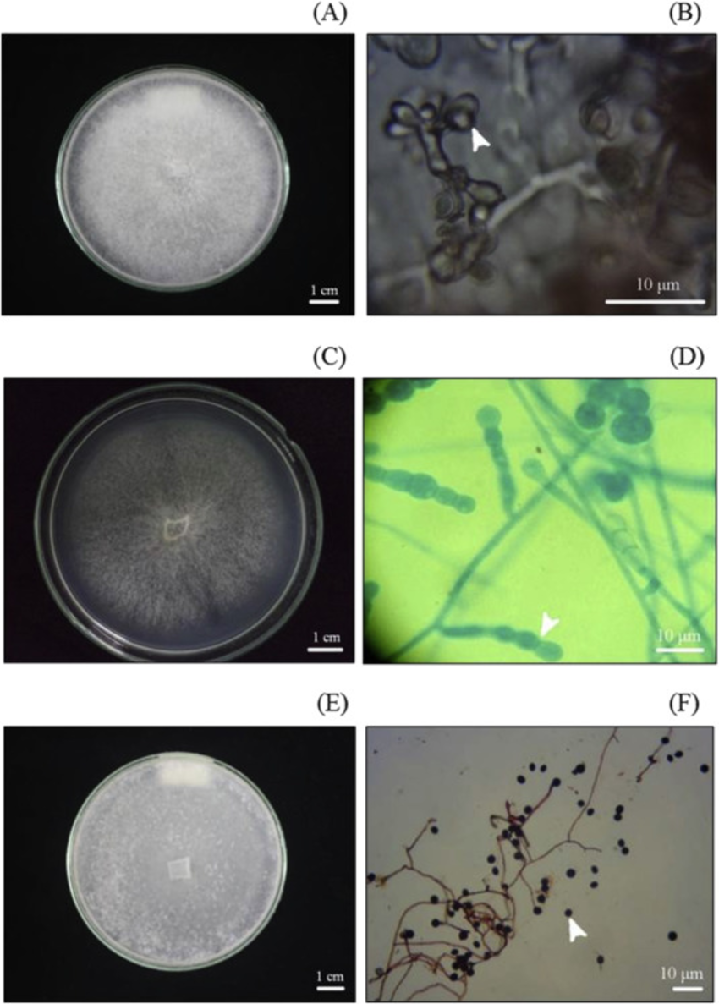
Figure 2: Cultural and morphological characteristics of mycorrhizal fungi on PDA: (A) Tulasnella violea; (B) Basidiospores of T. violea (white arrow); (C) Epulorhiza sp; (D) Monilioid cells of Epulorhiza sp. (white arrow); (E) Trichosporiella multisporum; (F) Conidiospore of Trichosporiella mutisporum (white arrow).

Slide 10
